Slide 1
計算機概論實習
Week6(2020/10/20)
FILE IO
Lab: EC 118
助教:
陳作源 russchen.cs08g@nctu.edu.tw
陳彥銨 my91015.cs08g@nctu.edu.tw
鄭智仁 king601012003.cs08g@nctu.edu.tw

Slide 2
FILE IO
open a file
process the file
read from the file
reposition stream position indicator
write to the file
close a file

Slide 3
open a file: fopen
FILE *fptr
declare a variable named “fptr”, and its type is a pointer that points to the location of a file
fptr = fopen("test.txt", "w");
the value of fptr is the location of “test.txt”
the file you want to open
1. you can specify the path
2. default: same path to cpp file
mode

Slide 4
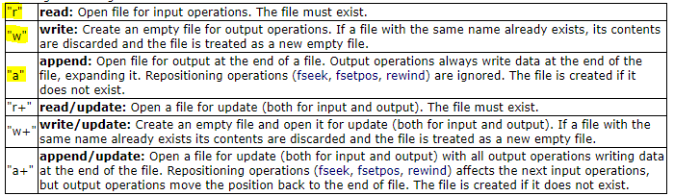
open a file: fopen
FILE *fptr
fptr = fopen("test.txt", "w");
the file you want to open
1. you can specify the path
2. default: same path to cpp file
mode

Slide 5
close a file: fclose
close a file and release memory.
fclose(filename)
There is a limit number of files you can open in the same time. Therefore, you need to close the unnecessary files.
Not calling fclose() can result in fprintf() invalid.
the file pointer we declared

Slide 6

Write to file
fprintf | fprintf(file pointer, ’’datatype”,output data); write formatted data Ex: fprintf(fptr, "%d“, x);
putc | putc(char, file pointer); write char to the file pointed by file pointer Ex: putc(ch, fptr);
fputs | fputs(string, file pointer) write string to the file pointed by file pointer Ex: fputs(str, fptr);

Slide 7
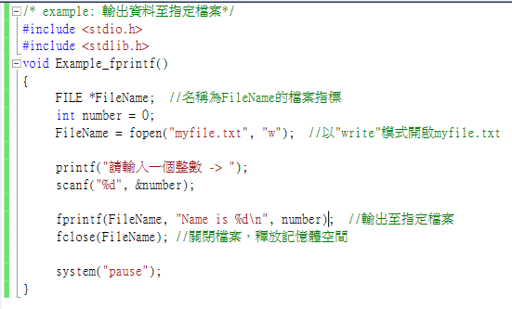

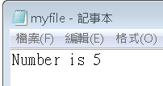
Example
specify address, ex: “D://abc.txt”
default: same path to cpp file
// This example shows how to write data to file
//declare a file pointer named “FileName”
//open “myfile.txt” with “write” mode
// please enter an integer
//write out to the file
//close the file and release its memory

Slide 8
Read from file
fscanf | fscanf(file pointer, ”datatype”, input data); read formatted data Ex: fscanf(fptr,"%d%s",&x, y);
getc | variable = getc(file pointer); read a char from the file pointed by file pointer and return the char Ex: ch = getc(fptr);
fgets | fgets(string, num, file pointer) read chars from the file pointed by the file pointer and store them into a char array with a max number of (num-1) being read Ex: fgets(str, 15, fptr)

Slide 9
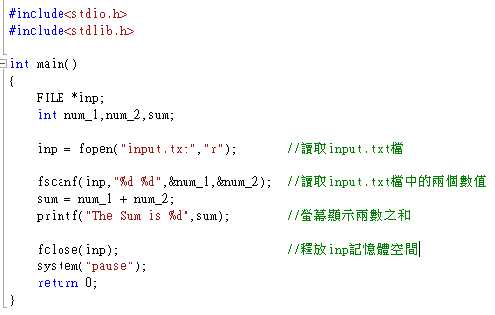
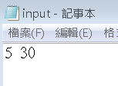

Example：fscanf
//open “input.txt”
//read two integers from the file
//print out the sum
//release memory

Slide 10
EOF
To check whether you have reached the end of the file (End of File, EOF)。
In <stdio.h> EOF is defined as -1。

Slide 11
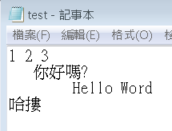
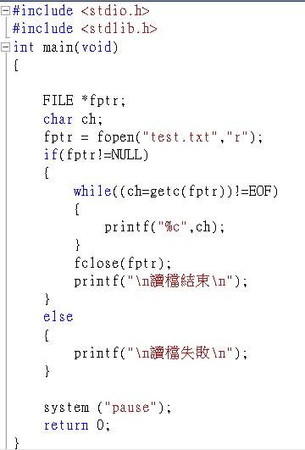
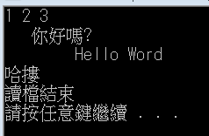
Example： getc()
//if successfully open file
//if not finish reading
//finish reading file
//finish reading file
// fail to open file
//fail to read the file

Slide 12
Reposition stream position indicator
fseek(file pointer, offset, from where)
保留字 | 意義與用法
SEEK_SET | EX : fseek ( fptr , 0 , SEEK_SET ) reposition cursor(fptr，offset=0，counting from the start of the file)
SEEK_CUR | EX : fseek ( fptr , 1 , SEEK_CUR ) reposition cursor(fptr，offset=1，counting from the current postion)
SEEK_END | EX : fseek ( fptr , -1 , SEEK_END ) reposition cursor(fptr，offset=-1，counting from the end of the file)

Slide 13
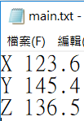
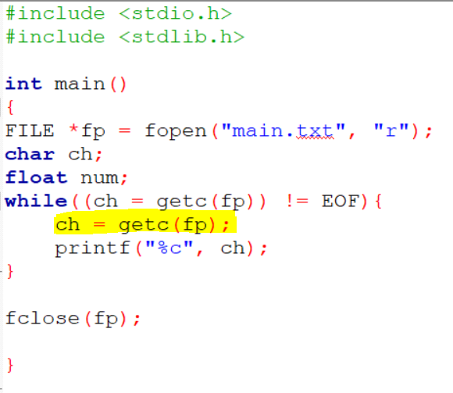
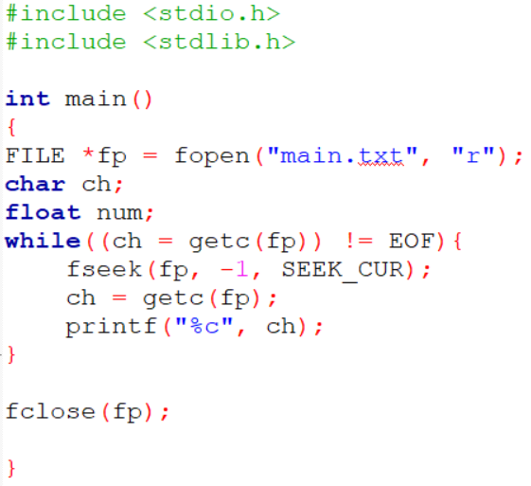
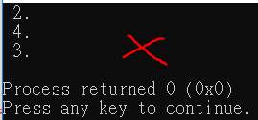
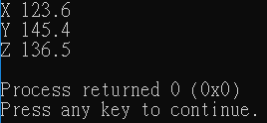
Example：fseek

Slide 14
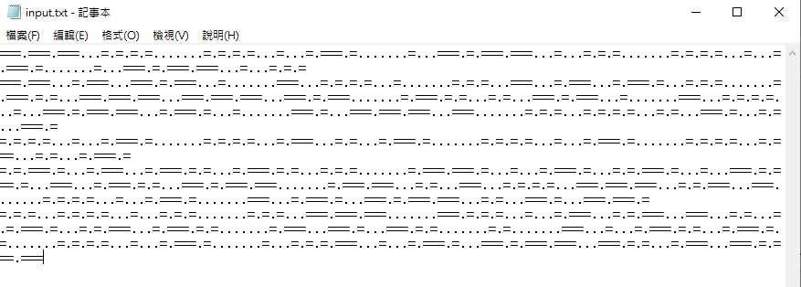
Exercise
One day, you receive a love letter that is composed of many ‘=’ and ‘.’ and immediately recognizing those being conversion of morse codes.
Classical morse code has the table (already given):

Slide 15
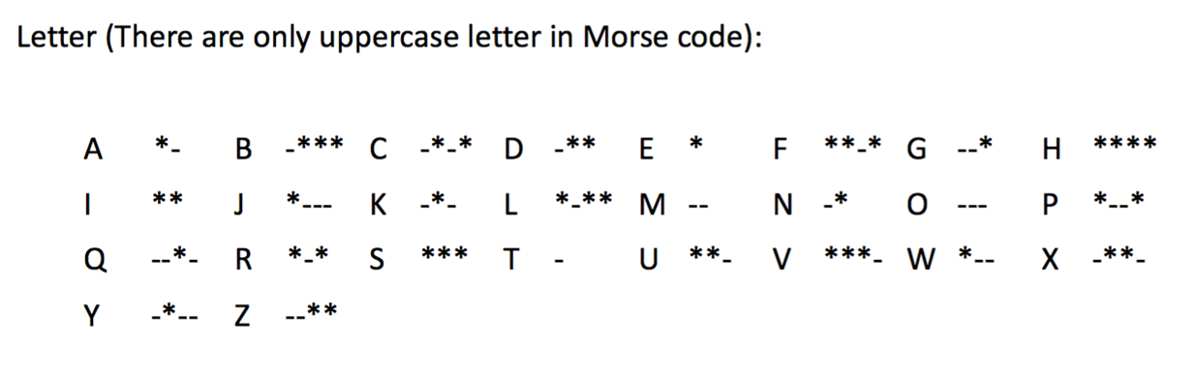
Exercise
One day, you receive a love letter that is composed of many ‘=’ and ‘.’ and immediately recognizing those being conversion of morse codes.
Classical morse code has the table (already given):
where ‘*’ denotes a short signal, and ‘-’ denotes a long signal.

Slide 16
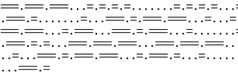
Exercise
Now you think the conversion of morse code has the rule:
“===” represents a long signal.
‘=’ represents a short signal.
For a letter, ‘.’ is used as a pause to separate signals.
In a word, “…” is used as a pause to separate letters.
“…….” is used to separate words (a blank).
A table for classical morse code is already given in “Morse_code_easy.cpp”. All you have to do is first convert the classical morse code into the conversion version. Read the input.txt and map into a readable output.txt and save it.
Please do not make any modifications to “input.txt”.

Slide 17
Exercise
pause between signals
pause between words
pause between letters
long signal
=.=.=.=...=...=.===.=.=...=.===.=.=...===.===.===.......===.=...===.=.===.=...===...=.=.===
short signal
H
=.=.=.=...=...=.===.=.=...=.===.=.=...===.===.===.......===.=...===.=.===.=...===...=.=.===

Slide 18
Exercise
pause between signals
pause between words
pause between letters
long signal
=.=.=.=...=...=.===.=.=...=.===.=.=...===.===.===.......===.=...===.=.===.=...===...=.=.===
short signal
H E
=.=.=.=...=...=.===.=.=...=.===.=.=...===.===.===.......===.=...===.=.===.=...===...=.=.===

Slide 19
Exercise
pause between signals
pause between words
pause between letters
long signal
=.=.=.=...=...=.===.=.=...=.===.=.=...===.===.===.......===.=...===.=.===.=...===...=.=.===
short signal
H E L
=.=.=.=...=...=.===.=.=...=.===.=.=...===.===.===.......===.=...===.=.===.=...===...=.=.===

Slide 20
Exercise
pause between signals
pause between words
pause between letters
long signal
=.=.=.=...=...=.===.=.=...=.===.=.=...===.===.===.......===.=...===.=.===.=...===...=.=.===
short signal
H E L L
=.=.=.=...=...=.===.=.=...=.===.=.=...===.===.===.......===.=...===.=.===.=...===...=.=.===

Slide 21
Exercise
pause between signals
pause between words
pause between letters
long signal
=.=.=.=...=...=.===.=.=...=.===.=.=...===.===.===.......===.=...===.=.===.=...===...=.=.===
short signal
H E L L O
=.=.=.=...=...=.===.=.=...=.===.=.=...===.===.===.......===.=...===.=.===.=...===...=.=.===

Slide 22
Exercise
pause between signals
pause between words
pause between letters
long signal
=.=.=.=...=...=.===.=.=...=.===.=.=...===.===.===.......===.=...===.=.===.=...===...=.=.===
short signal
H E L L O (space)
=.=.=.=...=...=.===.=.=...=.===.=.=...===.===.===.......===.=...===.=.===.=...===...=.=.===

Slide 23
Exercise
pause between signals
pause between words
pause between letters
long signal
=.=.=.=...=...=.===.=.=...=.===.=.=...===.===.===.......===.=...===.=.===.=...===...=.=.===
short signal
H E L L O (space) N C
=.=.=.=...=...=.===.=.=...=.===.=.=...===.===.===.......===.=...===.=.===.=...===...=.=.===
T U

Slide 24
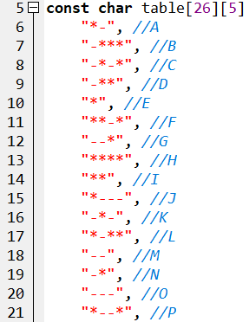
Exercise
“===” represents a long signal.
‘=’ represents a short signal.
For a letter, ‘.’ is used as a pause to separate signals.
Building the table
* | - | * | *
= | .

Slide 25
Exercise
“===” represents a long signal.
‘=’ represents a short signal.
For a letter, ‘.’ is used as a pause to separate signals.
Building the table
* | - | * | *
= | . | = | = | = | .

Slide 26
Exercise
“===” represents a long signal.
‘=’ represents a short signal.
For a letter, ‘.’ is used as a pause to separate signals.
Building the table
* | - | * | *
= | . | = | = | = | . | = | .

Slide 27
Exercise
“===” represents a long signal.
‘=’ represents a short signal.
For a letter, ‘.’ is used as a pause to separate signals.
Building the table
* | - | * | *
= | . | = | = | = | . | = | . | = | .

Slide 28
Exercise
“===” represents a long signal.
‘=’ represents a short signal.
For a letter, ‘.’ is used as a pause to separate signals.
2. parsing one string
H E L L O (space) N C
=.=.=.=...=...=.===.=.=...=.===.=.=...===.===.===.......===.=...===.=.===.=...===...=.=.===
when to cut?
“...”
“.......”
T U
dots = 0
sections = 0
=

Slide 29
Exercise
“===” represents a long signal. (hitting table for 3 times)
‘=’ represents a short signal. (hitting table for 1 time)
For a letter, ‘.’ is used as a pause to separate signals.
2. parsing one string
H E L L O (space) N C
=.=.=.=...=...=.===.=.=...=.===.=.=...===.===.===.......===.=...===.=.===.=...===...=.=.===
when to cut?
“...”
“.......”
T U
dots = 1
sections = 0
= | .

Slide 30
Exercise
“===” represents a long signal. (hitting table for 3 times)
‘=’ represents a short signal. (hitting table for 1 time)
For a letter, ‘.’ is used as a pause to separate signals.
2. parsing one string
H E L L O (space) N C
=.=.=.=...=...=.===.=.=...=.===.=.=...===.===.===.......===.=...===.=.===.=...===...=.=.===
when to cut?
“...”
“.......”
T U
dots = 0
sections = 0
= | . | =

Slide 31
Exercise
“===” represents a long signal. (hitting table for 3 times)
‘=’ represents a short signal. (hitting table for 1 time)
For a letter, ‘.’ is used as a pause to separate signals.
2. parsing one string
H E L L O (space) N C
=.=.=.=...=...=.===.=.=...=.===.=.=...===.===.===.......===.=...===.=.===.=...===...=.=.===
when to cut?
“...”
“.......”
T U
dots = 1
sections = 0
= | . | = | .

Slide 32
Exercise
“===” represents a long signal. (hitting table for 3 times)
‘=’ represents a short signal. (hitting table for 1 time)
For a letter, ‘.’ is used as a pause to separate signals.
2. parsing one string
H E L L O (space) N C
=.=.=.=...=...=.===.=.=...=.===.=.=...===.===.===.......===.=...===.=.===.=...===...=.=.===
when to cut?
“...”
“.......”
T U
dots = 0
sections = 0
= | . | = | . | =

Slide 33
Exercise
“===” represents a long signal. (hitting table for 3 times)
‘=’ represents a short signal. (hitting table for 1 time)
For a letter, ‘.’ is used as a pause to separate signals.
2. parsing one string
H E L L O (space) N C
=.=.=.=...=...=.===.=.=...=.===.=.=...===.===.===.......===.=...===.=.===.=...===...=.=.===
when to cut?
“...”
“.......”
T U
dots = 1
sections = 0
= | . | = | . | = | .

Slide 34
Exercise
“===” represents a long signal. (hitting table for 3 times)
‘=’ represents a short signal. (hitting table for 1 time)
For a letter, ‘.’ is used as a pause to separate signals.
2. parsing one string
H E L L O (space) N C
=.=.=.=...=...=.===.=.=...=.===.=.=...===.===.===.......===.=...===.=.===.=...===...=.=.===
when to cut?
“...”
“.......”
T U
dots = 0
sections = 0
= | . | = | . | = | . | =

Slide 35
Exercise
“===” represents a long signal. (hitting table for 3 times)
‘=’ represents a short signal. (hitting table for 1 time)
For a letter, ‘.’ is used as a pause to separate signals.
2. parsing one string
H E L L O (space) N C
=.=.=.=...=...=.===.=.=...=.===.=.=...===.===.===.......===.=...===.=.===.=...===...=.=.===
when to cut?
“...”
“.......”
T U
dots = 1
sections = 0
= | . | = | . | = | . | = | .

Slide 36
Exercise
“===” represents a long signal. (hitting table for 3 times)
‘=’ represents a short signal. (hitting table for 1 time)
For a letter, ‘.’ is used as a pause to separate signals.
2. parsing one string
H E L L O (space) N C
=.=.=.=...=...=.===.=.=...=.===.=.=...===.===.===.......===.=...===.=.===.=...===...=.=.===
when to cut?
“...”
“.......”
T U
dots = 2
sections = 0
= | . | = | . | = | . | = | . | .

Slide 37
Exercise
“===” represents a long signal. (hitting table for 3 times)
‘=’ represents a short signal. (hitting table for 1 time)
For a letter, ‘.’ is used as a pause to separate signals.
2. parsing one string
H E L L O (space) N C
=.=.=.=...=...=.===.=.=...=.===.=.=...===.===.===.......===.=...===.=.===.=...===...=.=.===
when to cut?
“...”
“.......”
T U
dots = 3
sections = 1
\0
= | . | = | . | = | . | = | . | . | .

Slide 38
Exercise
“===” represents a long signal. (hitting table for 3 times)
‘=’ represents a short signal. (hitting table for 1 time)
For a letter, ‘.’ is used as a pause to separate signals.
2. parsing one string
H E L L O (space) N C
=.=.=.=...=...=.===.=.=...=.===.=.=...===.===.===.......===.=...===.=.===.=...===...=.=.===
when to cut?
“...”
“.......”
T U
dots = 3
sections = 4
\0
= | . | = | . | = | . | = | . | . | .
= | \0
= | . | = | = | = | . | = | . | = | \0

